Slide 1
Introduction to Data Analysis with R
Gladstone Institutes
Ayushi Agrawal
Bioinformatics Core, GIDB
July 12 & 14, 2022

Slide 2
Introductions
Ayushi Agrawal, Bioinformatician II
Michela Traglia, Statistician III (T.A.)
Min-Gyoung Shin, Bioinformatician II (T.A.)
Yihang Xin, Software Engineer II (T.A.)

Slide 3
Poll question
Prior experience with R?
None - I do not know what R is
Beginner - I can perform basic operations in R
Intermediate - I have used R before for some analyses
Expert - I use R all the time

Slide 4
R topics covered
Session 1 (Day 1)
RStudio interface
Basic math operations
Assigning values to variables
Commenting in a script
Logical operators
Data structures available in R
Saving R script and workspace
Intro to functions and libraries
Session 2 (Day 2)
Reading data
Troubleshooting error messages
Exploring data. (Basic summaries such as mean, median, etc.)
Selecting subsets of data
Plotting data
Notes:
For the absolute beginner.

Slide 5
Session 1

Slide 6
Session 1 Outline
Introduction
Motivation
RStudio interface
Basic math operations
Assigning values to variables
Commenting in a script
Logical operators
Data structures available in R
Saving R script and workspace
Intro to functions and libraries
Hands-on work in RStudio
Notes:
Questions: How many have experience with programming?
How many have experience with R?
How many feel the need for data analytic tools?

Slide 7
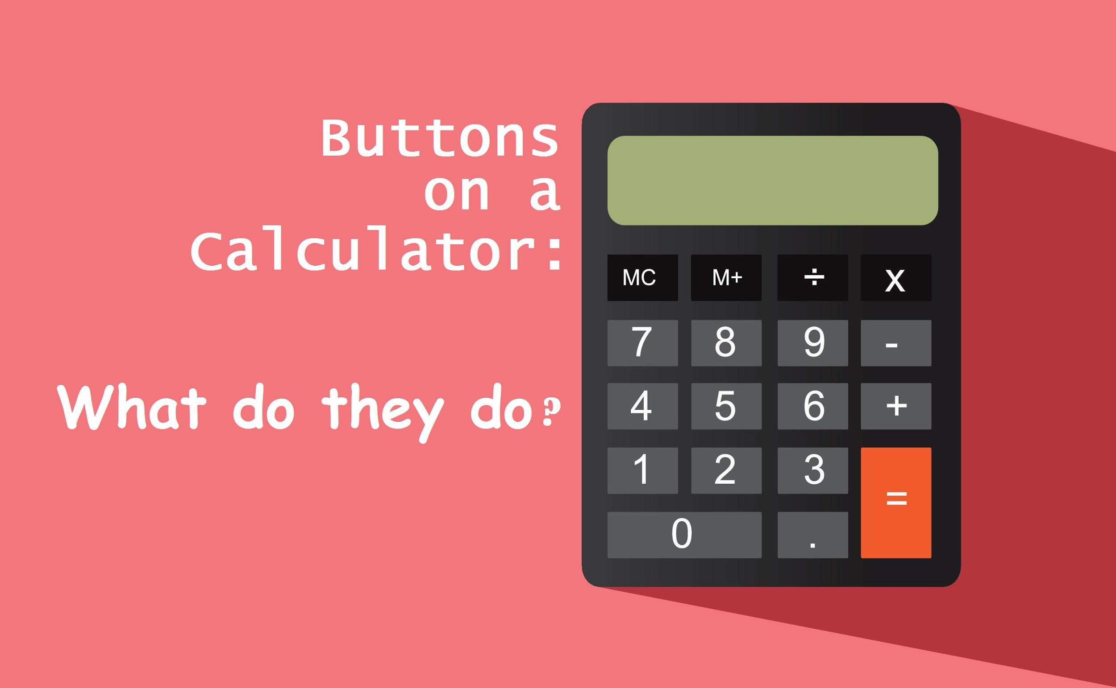
R:= A calculator with more “buttons” than you will ever use.
R can do all that a calculator can.
Open R.
Try 2+3.
Try 2*3.
Try (2+3)/5.
Conclusion: Off with the calculators!

Slide 8
What is R?
Collection of “buttons” that will perform mathematical calculations when pressed. The way to press “buttons” in R is by writing a command. Examples:
sum(2, 3)
prod(2,3)
sqrt(4)
R is a language and environment for statistical computing and graphics.
Links for useful R commands:
https://www.calvin.edu/~scofield/courses/m143/materials/RcmdsFromClass.pdf
https://www.personality-project.org/r/r.commands.html
https://github.com/rstudio/cheatsheets/blob/main/base-r.pdf
https://www.rstudio.com/resources/cheatsheets/

Slide 9
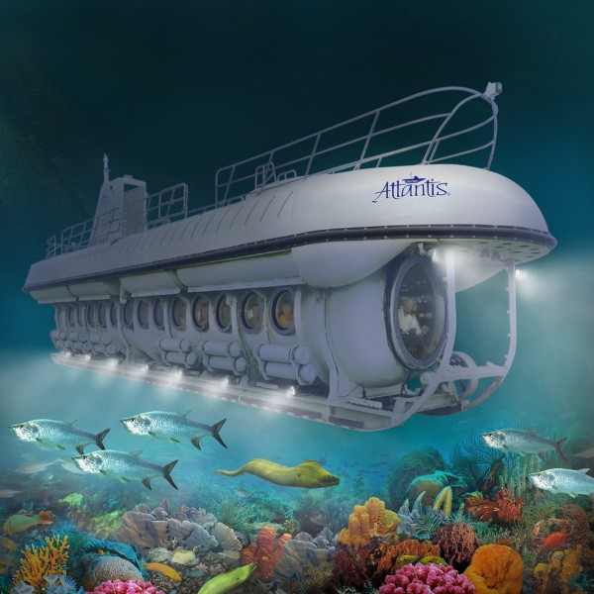

Excel: A boat to explore the surface of “Data-lantic ocean”. R: A submarine for deep exploration.
Excel
R

Slide 10
R offers a lot more than Excel.
Excel
R
Familiarity.
Simple visualizations only.
Simple statistics only. Limited support for advanced needs.
You know it’s falling short. That’s why you’re here.
Pay for an inferior option. Why?
Unknown territory.
Visualization heaven.
If there is a statistical method out there, you’ll likely find it in R. All you need is to “hit a button”.
You will need it ever more.
Free of cost.

Slide 11
R: designed specifically to support variety of biological data analysis.
Bioconductor: Software for all kinds of biological data.
Understands file formats commonly used in biology.
Vetted by large community of users.
Frequently updated.
https://www.bioconductor.org/

Slide 12
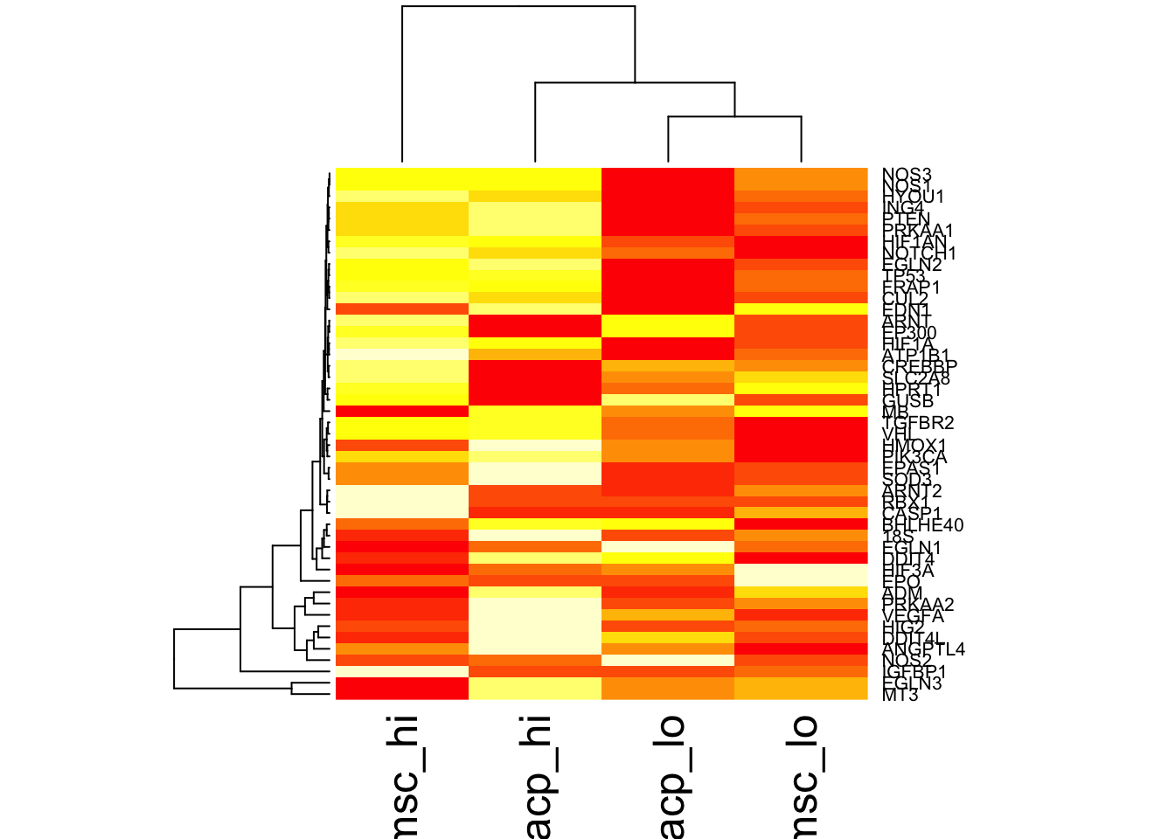
R: easy visualization of biological data. Supports interactive visualization.

Slide 13
R: Increasingly becoming more central to biology.
Biological software tools are being integrated with R.
Upcoming training workshops may require R.

Slide 14
R vs Python: depends on what we need
https://www.datacamp.com/community/tutorials/r-or-python-for-data-analysis
R is used by statisticians, engineers and scientists.
Python is popular among scientists, developers and programmers because it is faster.
R is primarily used in academics and research. Also common in industry for bioinformatics and data science.
Unique attractions of R: ggplot2 for data visualization, Bioconductor
Notes:
For more information on execution of R code, see:
https://subscription.packtpub.com/book/application_development/9781783989263/1/ch01lvl1sec09/r-is-interpreted-on-the-fly

Slide 15
RStudio and basic arithmetic

Slide 16
R is a console application.
Text only interface. Inputs and outputs can be images.
RStudio: Brings more Graphical User Interface (GUI) features to R.
RStudio is to R as Microsoft Word is to Notepad in Windows or TextEdit in Mac. (~kinda)
Launch RStudio.
Try from these:
sum(2,3)
prod(2,3)
sqrt(5.5)
Notes:
Four panes in Rstudio. Describe the panes.
Interactive console. Try basic math operations here.
Source code. Try writing the same operations here and go Cmd-A and Cmd-Enter. Also save the script. Run it.

Slide 17
Commenting inside a source script
Looking at an old script, or someone else’s script can be scary.
Speak to machine in code.
Leave comments in natural language (e.g., English).
Anything written after # is interpreted by R as a comment for humans.
Notes:
Show them how to leave comments.

Slide 18
Assignment operators in R
Results of one calculation may be input to another.
Save intermediate results by assigning them to variables.
a <- sum(2,3)
a = sum(2,3)
Variables store values.
Called so because they can be assigned any value.
Both work but prefer to use ‘<-’ for now.
Change ‘=’ to ‘<-’ in the script and rerun.
Notes:
Calculate sum(2,3) and assign it to variable a.
Calculate prod(2,3) and assign it to variable b.
Calculate a-b and assign it to variable c.
Is c == 0?
Conclusion: summing numbers is not the same as multiplying them.

Slide 19
Rules for naming variables
Names can be a combination of letters, digits, period (.) and underscore (_).
It must start with a letter or a period. If it starts with a period, it cannot be followed by a digit.
Reserved words in R must not be used as variable names.
Notes:
Caclulate sum(2,3) and assign it to variable a.
Calculate prod(2,3) and assign it to variable b.
Calculate a-b and assign it to variable c.
Is c == 0?
Conclusion: summing numbers is not the same as multiplying them.

Slide 20

Empty workspace/environment

Slide 21
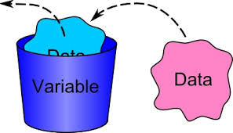
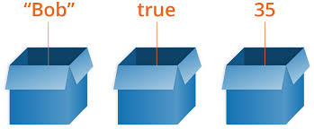

Data analysis creates objects that store data. (top-right pane in RStudio)

Slide 22
Scientific calculations may require checking criteria.
Is p-value less than 0.05?
Is organism named Homo sapiens?
What percent of patients have heart rate greater than 130 bpm?

Slide 23
Scientific calculations may require checking criteria.
Is p-value less than or equal to 0.05?
p <= 0.05
Is organism named Homo sapiens?
name == “Homo sapiens”
What percent of patients have heart rate greater than 130 bpm?
bpm > 130

Slide 24
Might need to check multiple criteria simultaneously.
p <= 0.05 & bpm > 130
bpm == 120 & name == “Homo sapiens”

Slide 25
Useful operators in R
! means ‘NOT’
!= means ‘NOT EQUAL’
== means ‘EQUAL’
& means ‘AND’
| means ‘OR’

Slide 26
Thus far…
R console
Source scripts
Commenting
Environment
Simple calculations
Variables

Slide 27
Coming up…
Data structures available in R.
Intro to functions and libraries.
Reading data.
Troubleshooting error messages.
Exploring data. (Basic summaries such as mean, median, etc.)
Selecting subsets of data.
Plotting data.

Slide 28
Data structures.

Slide 29
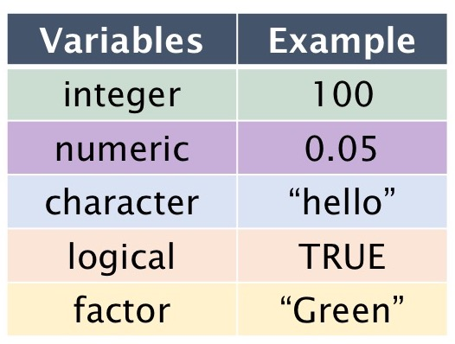
Data Types in R
https://sydney-informatics-hub.github.io/lessonbmc/02-BMC_R_Day1_B/index.html

Slide 30




Data structures are data organization/storage formats.
Storing data physically? Options:
Sticky note
Printer paper
Task pad
Long scroll

Slide 31
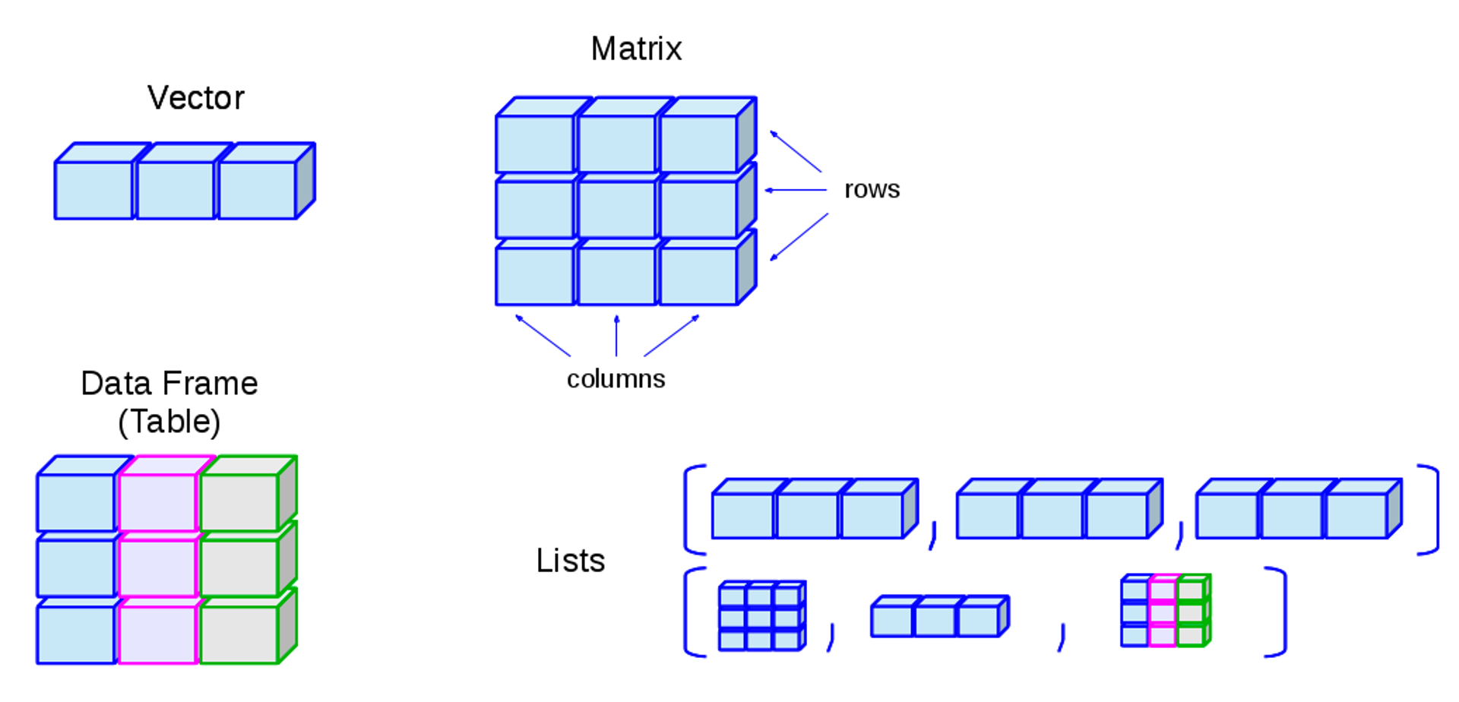
Data structures are data organization/storage formats.
http://venus.ifca.unican.es/Rintro/dataStruct.html

Slide 32
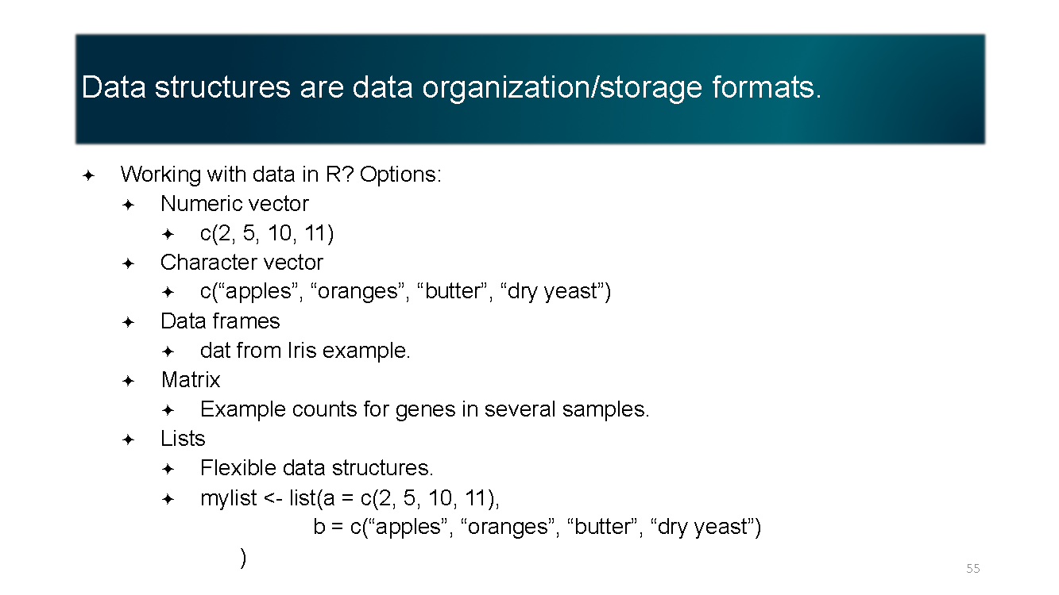
Data structures are data organization/storage formats.
Working with data in R? Options:
Numeric vector
c(2, 5, 10, 11)
Character vector
c(“apples”, “oranges”, “butter”, “dry yeast”)
Data frames
dat from Iris example.
Matrix
Example counts for genes in several samples.
Lists
Flexible data structures.
mylist <- list(a = c(2, 5, 10, 11),
b = c(“apples”, “oranges”, “butter”, “dry yeast”)
)

Slide 33
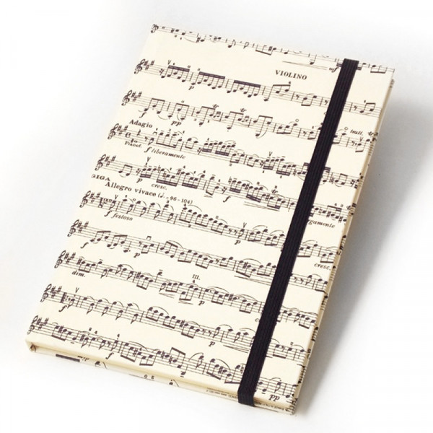
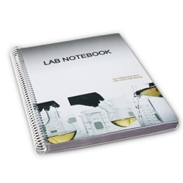
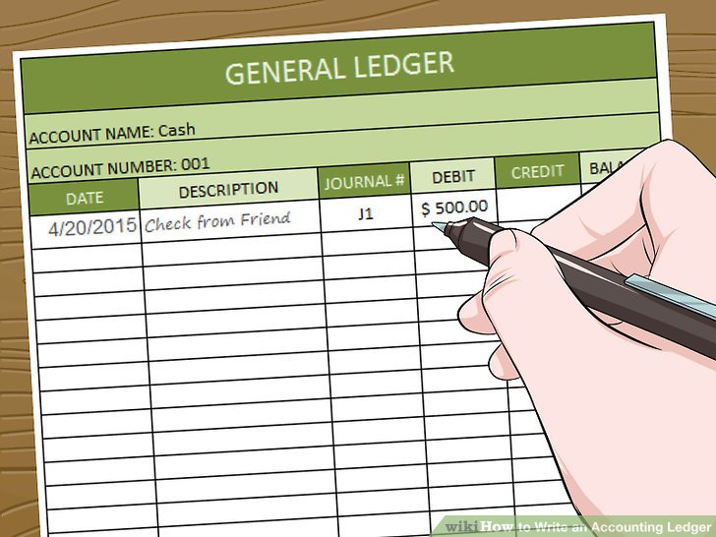
Data structures for special needs?
Storing data physically? Options:
Sheet music
Ledger
Lab notebook

Slide 34
Data structures for special needs?
Working with data in R?
Packages may have author-defined data structures.
Example – DGEList defined in edgeR.
Stores counts, sample grouping information, normalization factors, etc. in one place.

Slide 35
Functions

Slide 36
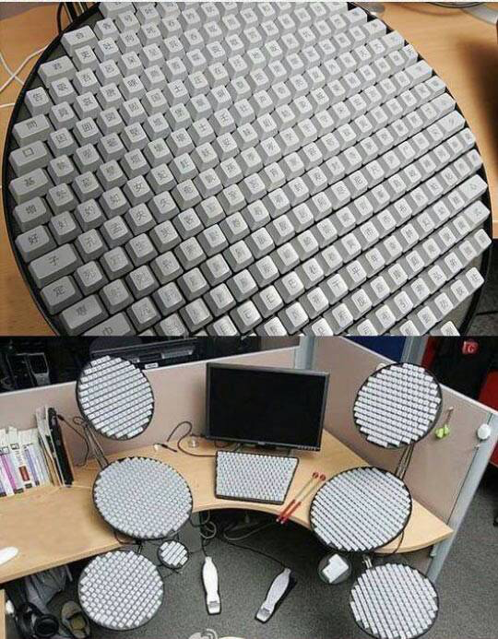
Working with buttons for modern scientific calculations?
The best of calculators => 10s of buttons for specific tasks.
Modern science needs many times more than 10s.

Slide 37
Functions are to R what buttons are to calculators.
R can perform 100s of 1000s of tasks.
Tasks are performed by using functions.
Examples: sum(), prod(), mean(), t.test().
Result1
DatasetA
function()
DatasetB
Result2
DatasetC
Result3

Slide 38
There are functions for all sorts of things.
Example to read a table saved in a file:
read.table()
Usage: read.table(“filename”)
read.table()
Data is displayed in R.
File name

Slide 39
There are functions for all sorts of things.
Example to find complementary DNA sequence.
complement()
Usage: complement(sequence)
complement()
TGCA
ACGT

Slide 40
Directing output of one function as input to another.
read.table()
edgeR()
List of differentially expressed genes.
Data is displayed in R.
File name

Slide 41
Library is a collection of functions.
R works with > 100000 functions.
More being added everyday.
If the software were to load (i.e., make available) all of them at startup, it will take a while to launch.
Solution: Bundle related functions together in a library.
Example: edgeR.
Load functions only when needed. (:= Install apps on smartphone as needed)

Slide 42
Functions may need lots of information
Calculators may take only numbers.
R functions take variety of things. Numbers, characters, etc.
Example:
Reading a file. Inputs required: File name and address on computer, formatting of file, type of file, etc.
Writing a file. Inputs required:
what to write?
where to write?
how to format the file?
Include column names, row names?
separate with comma?

Slide 43
Session 2

Slide 44
Session 2 Outline
Reading data
Troubleshooting error messages
Exploring data (Basic summaries such as mean, median, etc.)
Selecting subsets of data
Plotting data
Hands-on work in RStudio
Exercises
Conclusions
Notes:
Questions: How many have experience with programming?
How many have experience with R?
How many feel the need for data analytic tools?

Slide 45
Reading a data file.

Slide 46
There are functions for all sorts of things.
Functions to read files:
read.csv()
read.table()
read.xlsx()
Try reading a file called “GSE60450_Lactation-GenewiseCounts.txt”
read.table("GSE60450_Lactation-GenewiseCounts.txt")

Slide 47

Error!!!

Slide 48
How to find help?
Execute a command name with the question mark before it. Example:
?read.table
Read the error message!
Often, no need to understand every word.
Look for key words in error message.
Copy-paste the error message verbatim in Google!

Slide 49
We need to set directory to where the file is.
The function for this is:
setwd()
Can also do it interactively using the menu bar.
In RStudio: Session -> Set Working Directory -> Choose Working Directory.
Verify using
getwd()

Slide 50
Working with a dataset (Read, Subset, Visualize)

Slide 51
Reading a dataset
Function we will use: read.table().
Dataset used: GEO accession: GSE60450.
Tissue of origin: Mammary glands of mouse.
Cell types: Basal stem-cell enriched cells (B) and committed luminal cells (L)
Biological conditions: Virgin, Lactating and Pregnant
# of groups: 2 cell types x 3 conditions = 6 groups
# of replicates: 2 of each group
Try read.table("GSE60450_Lactation-GenewiseCounts.txt").
dat <- read.table("GSE60450_Lactation-GenewiseCounts.txt")

Slide 52
Explore the current data
View(dat) #Shows the data in a tabular format.
dim(dat) #Shows the dimensions of the table, i.e. rows and columns.
colnames(dat) #Shows the names of columns, if any.
summary(dat) #Outputs summary statistics of data. Ex- minimum, max, median, etc.
head(dat) #Displays first 6 rows of data.
tail(dat) #Displays last 6 rows of data.

Slide 53
Extracting parts of data in another variable.
geneIds <- dat$EntrezGeneID
$ is used to refer to a feature in the data.
Check what geneIds is.
class(geneIds)
geneIds is an ordered series of values.
Ordered series of values are called vectors in R.

Slide 54
Another data type: Factor
phenotype_info <- read.table("targets.csv", header = TRUE, sep = ",")
Check what phenotype_info$CellType is.
Character type.
Convert to factor.
phenotype_info$CellType <- as.factor(phenotype_info$CellType)
Factors are used to represent categorical variables for statistical analysis.

Slide 55
Goal: To extract subset of data for B cells.
which_B <- phenotype_info$CellType == "B"
phenotype_info$CellType == "B" compares each value in phenotype_info$CellType with the character “B”.
If a value equals “B”, output is TRUE.
Check what which_B is. (a logical vector)
To extract the subset for B cells:
phenotype_info_B <- phenotype_info[which_B, ]

Slide 56
Goal: To extract subset of data for B cells.
Alternatively
phenotype_info_B <- subset(phenotype_info, CellType == "B")
If only I had googled!!
Wishing you could just hit enter?
Feeling like a lot of people would want it?
Google!
TRUE for most anything at a beginner level.
If you get an error, someone else would have got it too. Google!

Slide 57
Basic statistics.
Mean
mean(dat$MCL1.DG_BC2CTUACXX_ACTTGA_L002_R1)
Median
median(dat$MCL1.DG_BC2CTUACXX_ACTTGA_L002_R1)
Standard deviation
sd(dat$MCL1.DG_BC2CTUACXX_ACTTGA_L002_R1)
Histogram
hist(dat$MCL1.DG_BC2CTUACXX_ACTTGA_L002_R1)
Boxplot
boxplot(dat$MCL1.DG_BC2CTUACXX_ACTTGA_L002_R1)

Slide 58
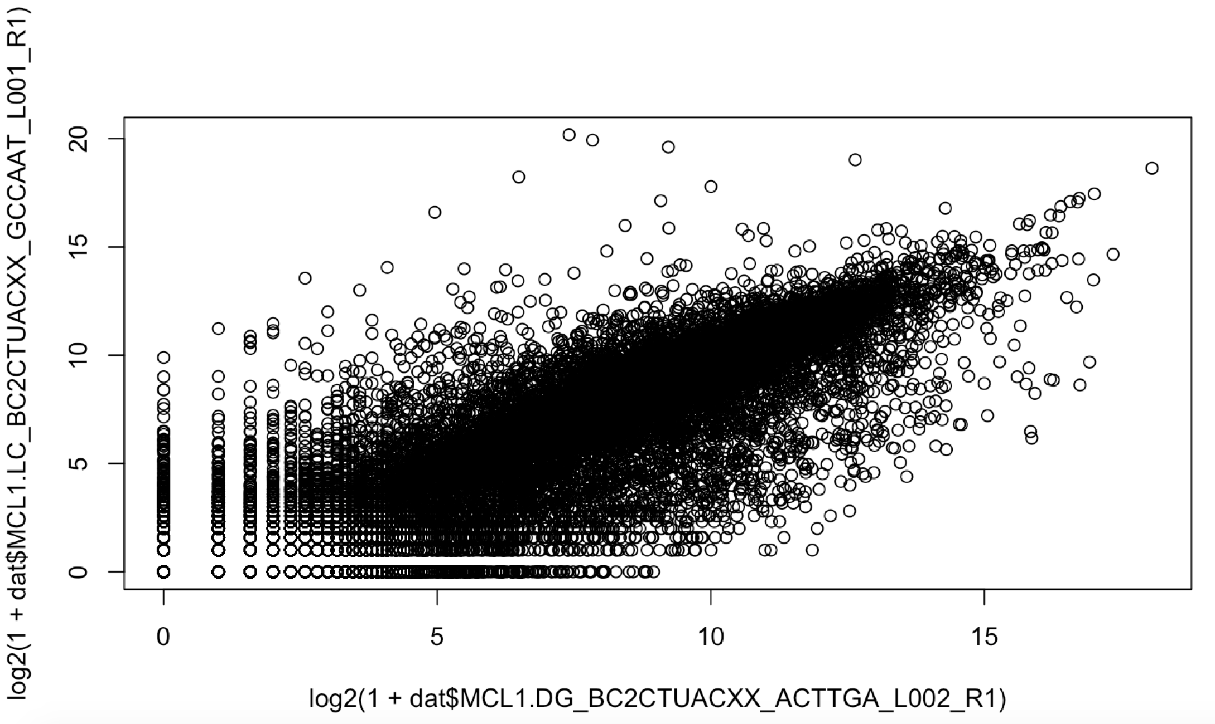
Visualizing data.
plot(x= log2(1 + dat$MCL1.DG_BC2CTUACXX_ACTTGA_L002_R1),
y= log2(1 + dat$MCL1.LC_BC2CTUACXX_GCCAAT_L001_R1))

Slide 59
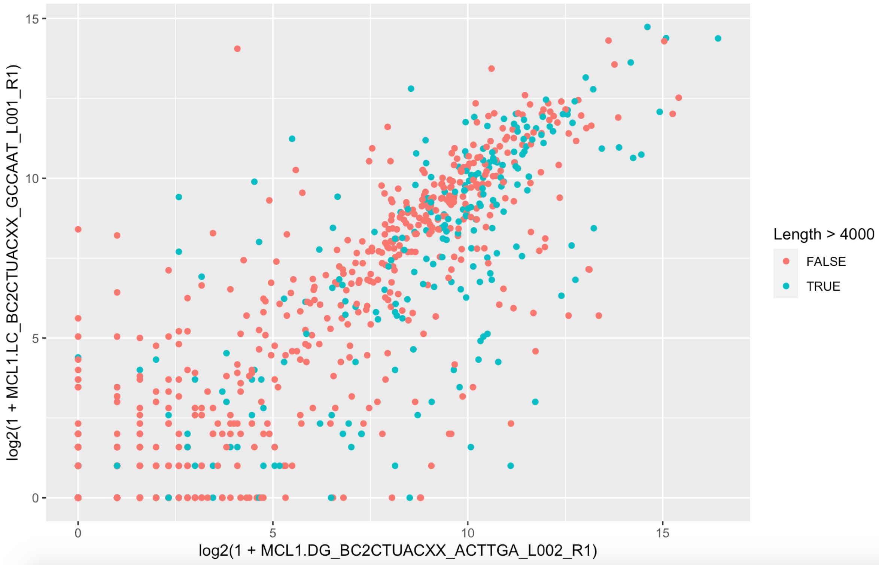
Visualizing data.
qplot(x = log2(1 + MCL1.DG_BC2CTUACXX_ACTTGA_L002_R1),
y = log2(1 + MCL1.LC_BC2CTUACXX_GCCAAT_L001_R1),
data = dat[1:1000, ], color = Length > 4000)

Slide 60
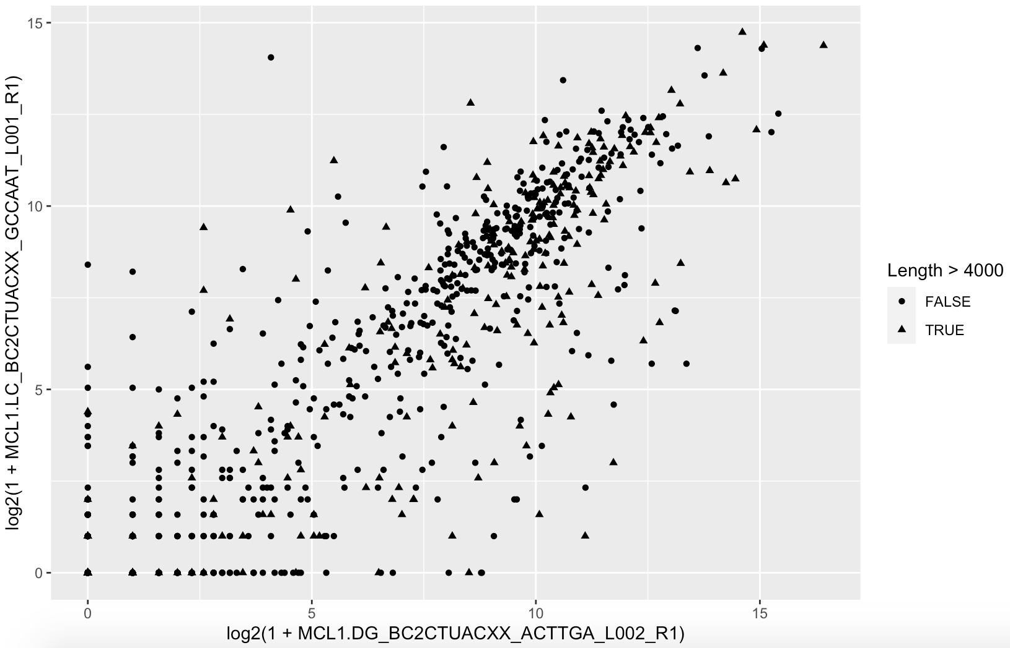
Visualizing data.
How to represent grouping of points using shape instead of color?

Slide 61
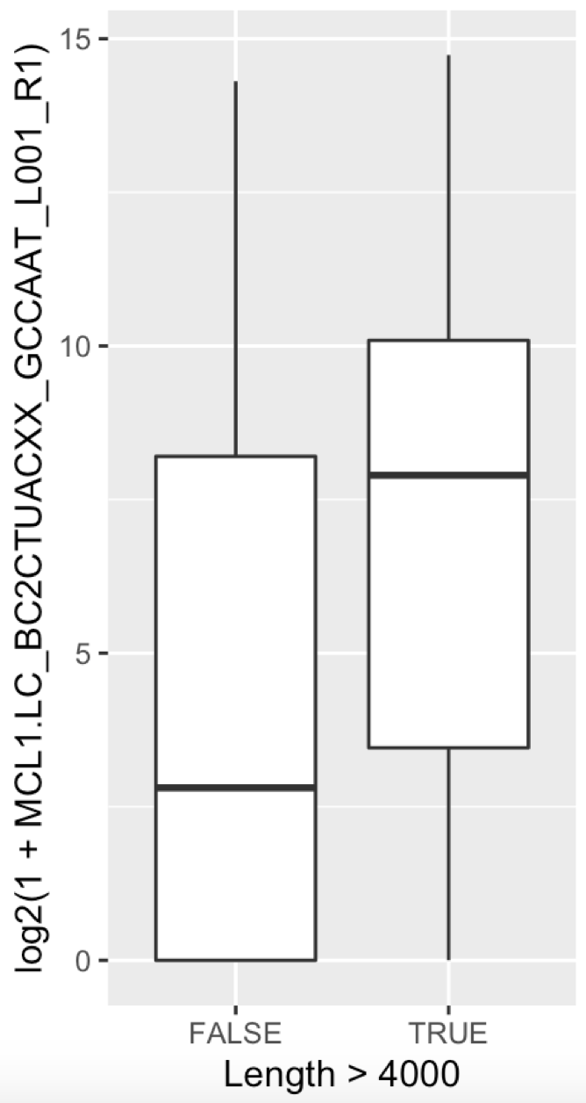
Visualizing data.
qplot(x = Length > 4000,
y = log2(1 + MCL1.LC_BC2CTUACXX_GCCAAT_L001_R1),
data = dat_subset[1:1000, ], geom = "boxplot")

Slide 62
Loops and conditional statements.

Slide 63
Loop over rows in a tabular data
table <- read.table(“targets.csv”)
for (row in table) {
#Do some calculation for each row
...
…
}

Slide 64
Conditional statements
if (p < 0.05) {
print(gene_info)
…
} else {
print(gene_name)
}

Slide 65
Exercise

Slide 66
Reading unclean data.
“dirty_data.txt” contains data that is formatted differently.
Figure out how to read it.
Tips:
Error message comes in peace. It is your friend!
Google!

Slide 67
Make volcano plots
“DE_result.txt” contains results from DE analysis of the count matrix we used.
Figure out how to make volcano plots.
Answer: Use the EnhancedVolcano package.

Slide 68
Alternative file types
Scientific studies may involve various kinds of files.
Example:
FASTA files for sequences.
FASTQ files for sequencing reads.
SAM files for alignment.
GTF files for gene annotations.
Excel sheets with multiple sheets.
Google for how to read FASTA file in R. (5 min)
Notes:
Show them how to open the fasta file.

Slide 69
How to read in FASTA files?
Searching for packages returns:
seqinr
Biostrings
…
Example with seqinr
install.packages(“seqinr”)
library(seqinr)
read.fasta(“16S.fasta”)
Check options available with read.fasta.
?read.fasta
Notes:
Show them how to open the fasta file.

Slide 70
Recap of R topics covered
RStudio interface.
Addition, subtraction, basic math operations.
Assigning values to variables.
Commenting in a script.
Logical operators.
Data structures available in R.
Intro to functions and libraries.
Reading data.
Troubleshooting error messages.
Exploring data. (Basic summaries such as mean, median, etc.)
Selecting subsets of data.
Plotting data.

Slide 71
Your feedback is important to us!
https://www.surveymonkey.com/r/F75J6VZ
~3 min.

Slide 72
Possibilities

Slide 73
Detailed high resolution graphics : Examples
https://www.r-graph-gallery.com/

Slide 74
Bioconductor for biological data analysis
Packages
edgeR, DESeq2, limma, voom
phyloseq, microbiome
rWikipathways, KEGGgraph
MSstats
bsseq, methylKit
chipseq
CRISPRseek, gCrisprTools, CrispRVariants
Uses
Differential gene expression analysis
Microbiome data analysis
Pathway analysis
Proteomic data analysis
DNA methylation analysis
ChIP-Seq data analysis
CRISPR related data analysis

Slide 75
Conclusions
R is a “smart” version of calculators.
Error message comes in peace.
Google!

Slide 76
Upcoming workshops
July 21-22 | Introduction to RNA-Seq Analysis
August 5 | Introduction to ggplot2 with R (UCSF Library)
August 15-16 | Hypothesis Testing
September 13 | Intermediate RNA-Seq Analysis Using R
Data Science Training Program
UCSF Library Data Science Initiative workshops

